Slide 1
FIN 740: Corporate Finance
Topic #4
Calculating Free Cash Flows

Slide 2
Outline for this topic
Continue “capital budgeting” decision by discussing how to calculate cash flows for project valuation
Discuss “free cash flows” (FCFs)
Define and explain FCFs
Steps to finding a project’s FCFs
Miscellaneous issues with FCFs
Apply tools using “Worldwide Paper” case

Slide 3
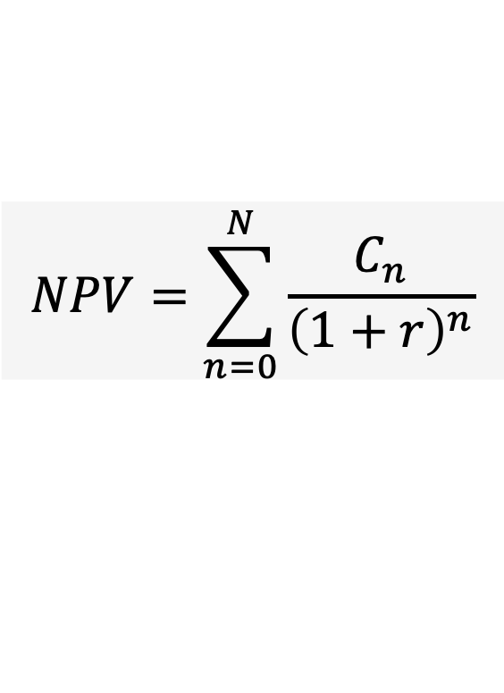
Motivation for calculating cash flows
Finding NPV helps managers allocate resources wisely
As discussed in last unit, NPV is given by
To date, I have just told you the relevant cash flows… This unit will discuss how to calculate those cash flows, C
$$NPV=\sum_{n=0}^{N}{\frac{C_{n}}{{\left(1+r\right)}^{n}}}$$
Before doing that, let’s briefly discuss the DCF methodology… What does it stand for? What is it?

Slide 4

Discounted cash flows (DCF) methodology
NPV is an example of the DCF methodology
DCF simply says that value of any asset is given by
CF_{t} = expected future cash stream in period t, where CF > 0 represents a cash inflow and CF < 0 represents a cash outflow
r = discount rate
$$Value={CF}_{0}+\frac{{CF}_{1}}{\left(1+r\right)}+\frac{{CF}_{2}}{{\left(1+r\right)}^{2}}+…+\frac{{CF}_{∞}}{{\left(1+r\right)}^{∞}}$$

Slide 5
DCF is used to value many assets
Corporate bonds
Share of stock
Entire firm
Projects (i.e., NPV)
We will return to valuing these assets in future topics
The goal for today is to show you how to estimate the relevant cash flows for a project!

Slide 6
Projects cause many incremental cash flows
To estimate a project’s value, one must first identify all the incremental cash flows caused by the project
This can be challenging because a project can have numerous cash flow implications…
What are some examples cash flows caused by new investments?
Intuitively, how do you think we estimate them?

Slide 7
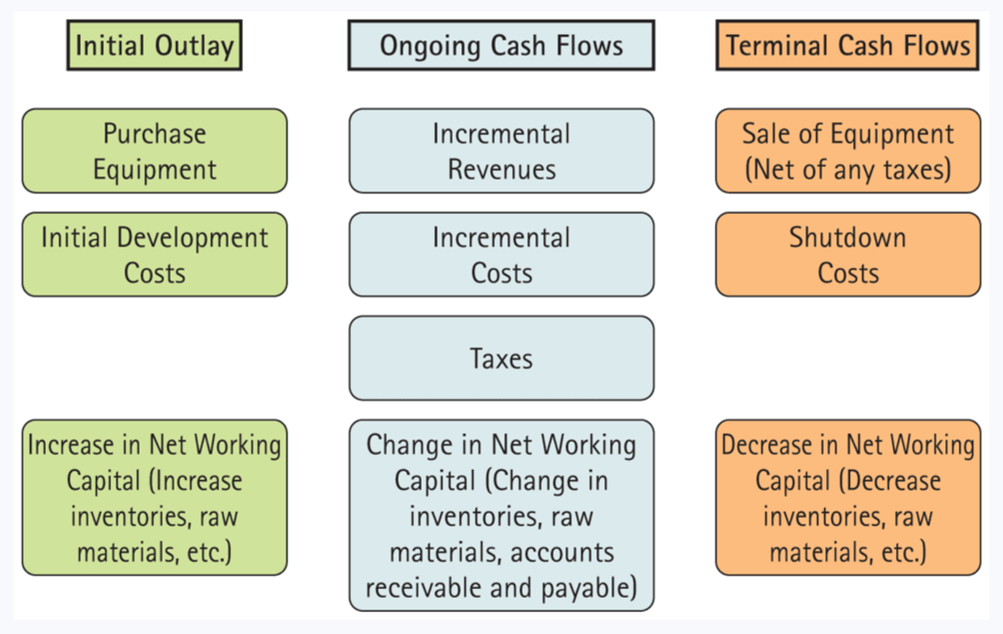
Typical project cash flows & their timing
Figure 9.1: Berk, Demarzo, and Harford, Fundamentals of Corporate Finance, 5th Edition

Slide 8
Introduction to free cash flows (FCFs)
Free cash flows is our way of organizing these numerous cash flows to find the total net change in cash flows…
How do you think we do this?
What do we mean by ‘free’?

Slide 9
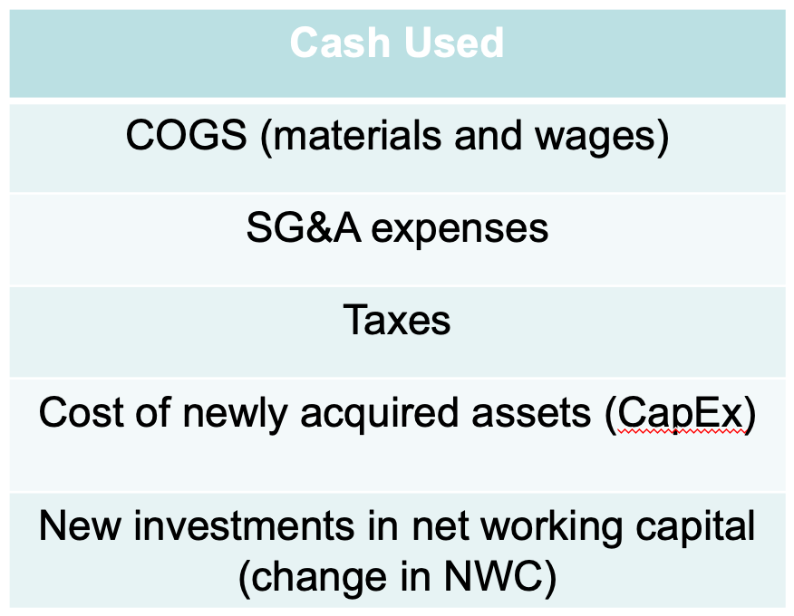
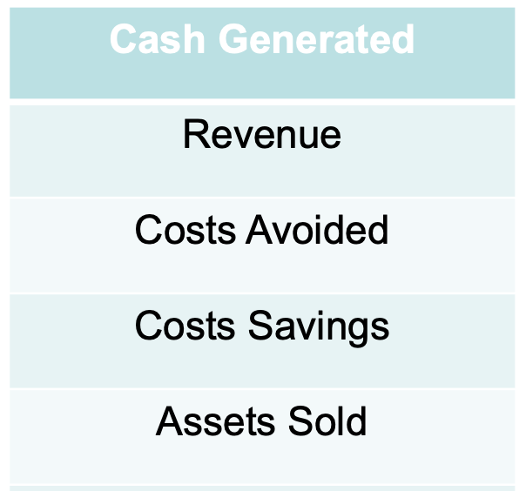
Organizing these cash flows to find FCF
Free cash flow

Slide 10
Free cash flow (FCF) – Definition
FCF is what’s left over at the end of each year from the firm’s operations that can be freely distributed to the investors of the firm, including…
Lenders [Banks, bondholders, etc.]
Owners [Shareholders]
I.e., FCF measures the net difference in cash generated and cash used, excluding financial items
Where is FCF found in a firm’s financial statements?

Slide 11
Outline for this topic
Continue “capital budgeting” decision by discussing how to calculate cash flows for project valuation
Discuss “free cash flows” (FCFs)
Define and explain FCFs
Steps to finding a project’s FCFs
Miscellaneous issues with FCFs
Apply tools using “Worldwide Paper” case

Slide 12
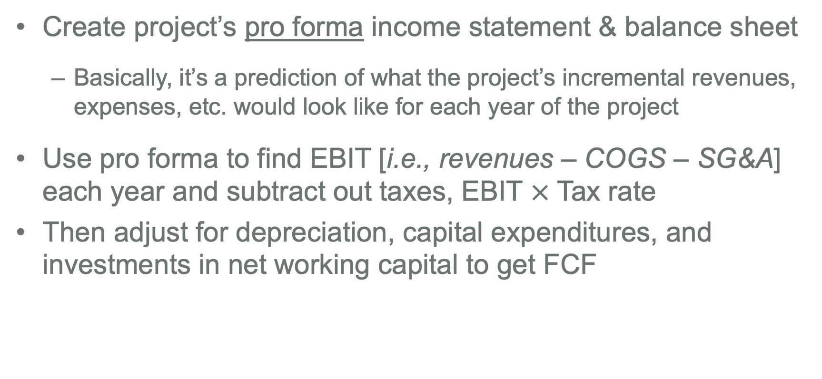
Basic steps to finding project’s FCF
Create project’s pro forma income statement & balance sheet
Basically, it’s a prediction of what the project’s incremental revenues, expenses, etc. would look like for each year of the project
Use pro forma to find EBIT [i.e., revenues – COGS – SG&A] each year and subtract out taxes, EBIT $×$ Tax rate
Then adjust for depreciation, capital expenditures, and investments in net working capital to get FCF
What does EBIT stand for?

Slide 13
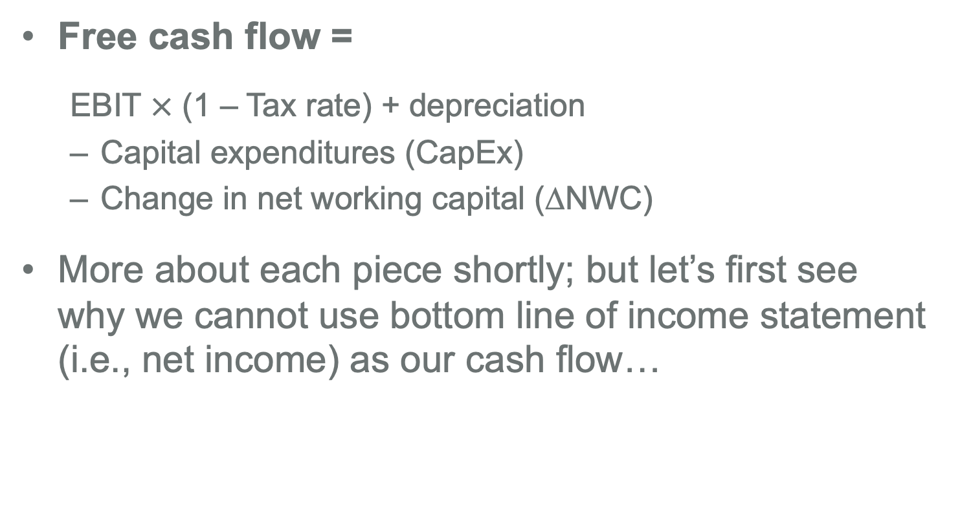
FCF formula
Note: Textbook also calls this piece unlevered income or incremental earnings
Free cash flow =
EBIT $×$ (1 – Tax rate) + depreciation
Capital expenditures (CapEx)
Change in net working capital (∆NWC)
More about each piece shortly; but let’s first see why we cannot use bottom line of income statement (i.e., net income) as our cash flow…

Slide 14
Why net income does NOT equal FCF
Net income removes interest expense, which is a use of FCF
Net income includes revenues and expenses when they accrue (i.e., when they are realized), not when they are paid
Hence, net income will include many things that are not cash flows
Two main areas in which this is a problem
#1 – Capital expenses and depreciation
#2 – Other non-cash items, e.g., accounts receivable

Slide 15
#1 – Capital expenses and depreciation
Capital expenses (purchase or sale of fixed assets) are not deducted, instead they are depreciated…
Suppose firm purchase $10,000 piece of equipment in year 1, and it is expected to last 5 years of use
Accrual method deducts depreciation when finding net income
Using “straight-line” approach, this means $2,000 expensed per year for year 1-5
But what is the actual cash flow in each year?

Slide 16
#2 – Other non-cash items
E.g., account receivables and payables
Increase in accounts receivable is counted in sales…
Increase in accounts payable is counted as expense…
What is an account receivable?
What is an account payable?
Did a cash flow occur in either case?

Slide 17
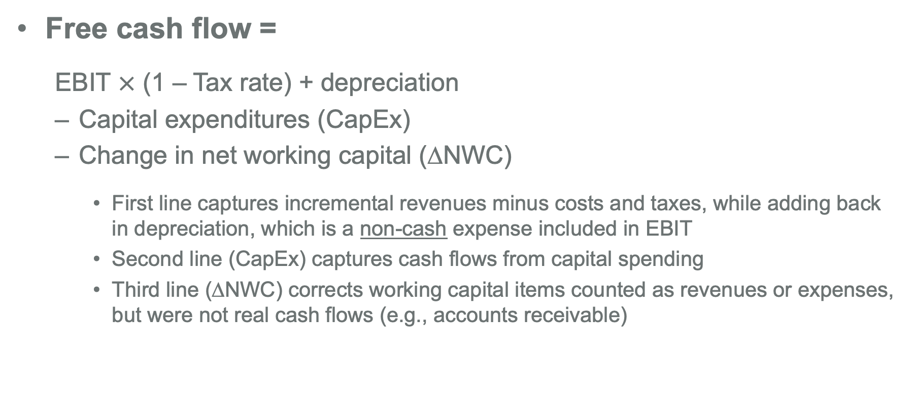
Three pieces to calculate FCF
Two important things to note about this first step…
Free cash flow =
EBIT $×$ (1 – Tax rate) + depreciation
Capital expenditures (CapEx)
Change in net working capital (∆NWC)
First line captures incremental revenues minus costs and taxes, while adding back in depreciation, which is a non-cash expense included in EBIT
Second line (CapEx) captures cash flows from capital spending
Third line (∆NWC) corrects working capital items counted as revenues or expenses, but were not real cash flows (e.g., accounts receivable)

Slide 18
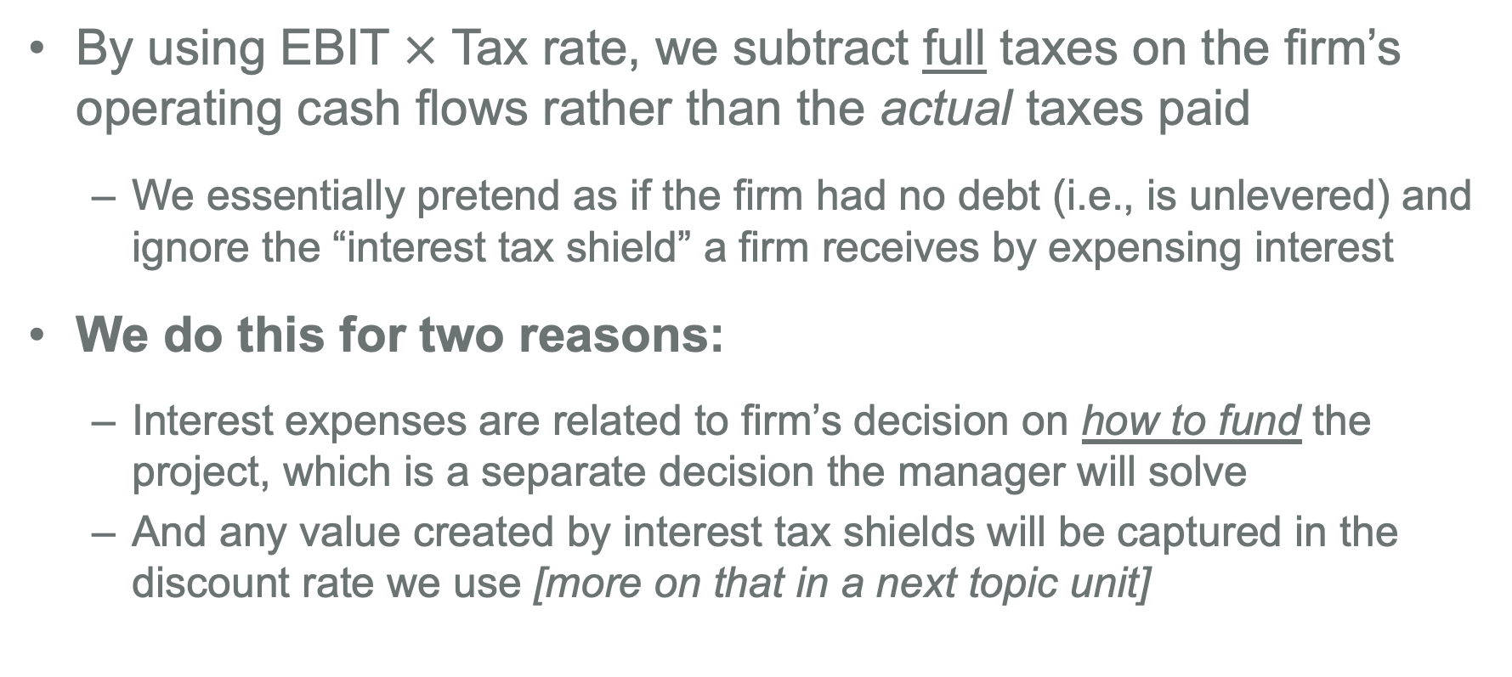
Note #1 – We do not include interest expenses
By using EBIT $×$ Tax rate, we subtract full taxes on the firm’s operating cash flows rather than the actual taxes paid
We essentially pretend as if the firm had no debt (i.e., is unlevered) and ignore the “interest tax shield” a firm receives by expensing interest
We do this for two reasons:
Interest expenses are related to firm’s decision on how to fund the project, which is a separate decision the manager will solve
And any value created by interest tax shields will be captured in the discount rate we use [more on that in a next topic unit]

Slide 19
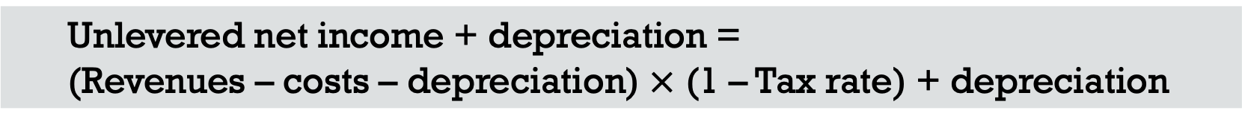
Note #2 – What’s up with the depreciation?
Students often wonder why this first step of FCF calculation subtracts depreciation but then adds it back in…
Unlevered net income + depreciation =
(Revenues – costs – depreciation) $×$ (1 – Tax rate) + depreciation
Why do we do this?

Slide 20
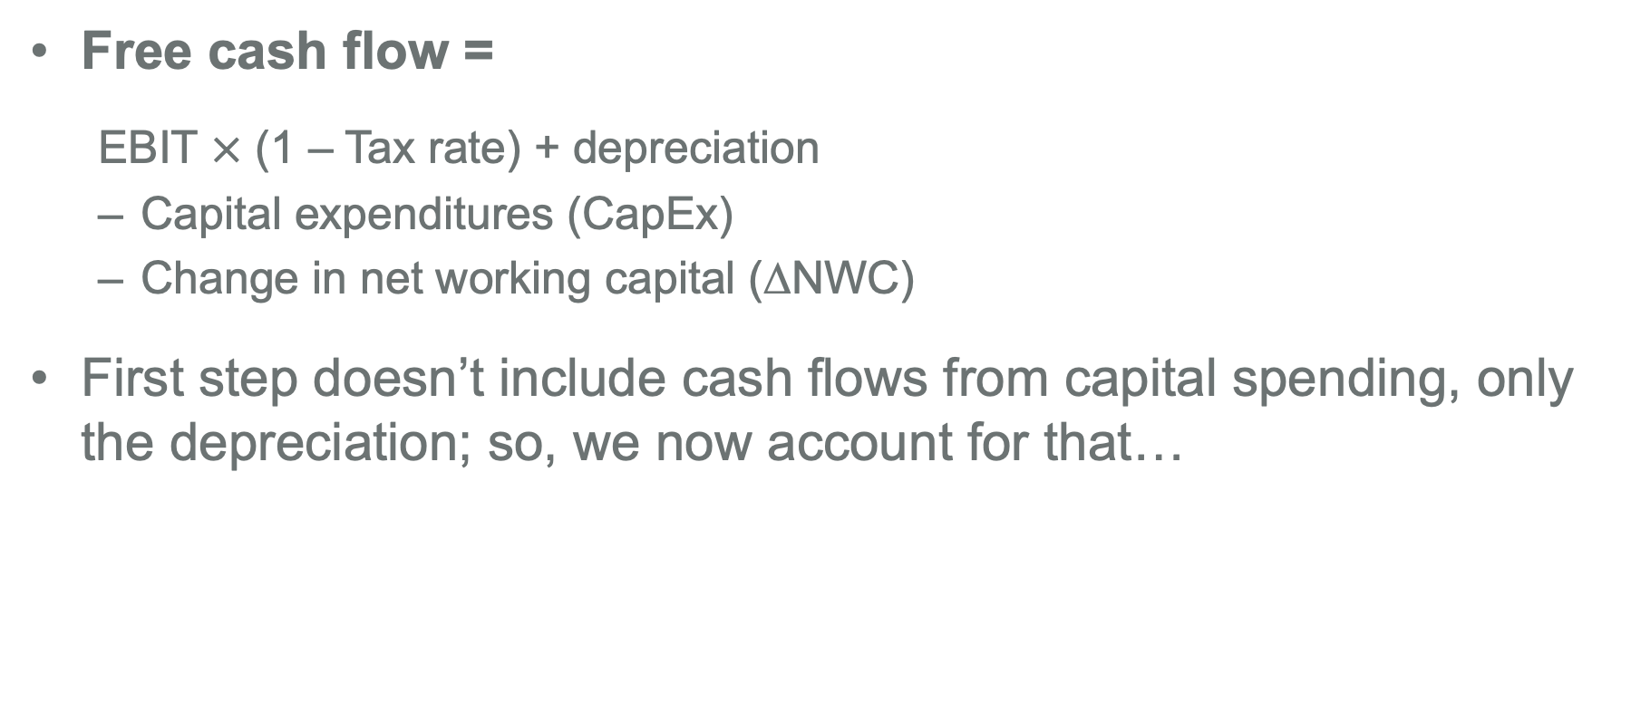
Next, find and subtract capital expenditures
Free cash flow =
EBIT $×$ (1 – Tax rate) + depreciation
Capital expenditures (CapEx)
Change in net working capital (∆NWC)
First step doesn’t include cash flows from capital spending, only the depreciation; so, we now account for that…

Slide 21
Estimating CapEx
You will need to estimate CapEx for each year of project
And don’t forget to account for any cash flows the firm gets when it sells off fixed assets, which are negative CapEx flows
See next slide for how to calculate this after-tax salvage value cash flow

Slide 22

Finding after-tax salvage value cash flow
First, find capital gain from sale of the asset:
Then, find after-tax cash flow from the asset sale:
Why does the government tax the capital gain?

Slide 23
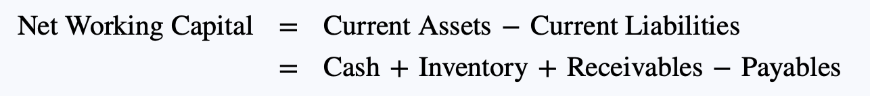
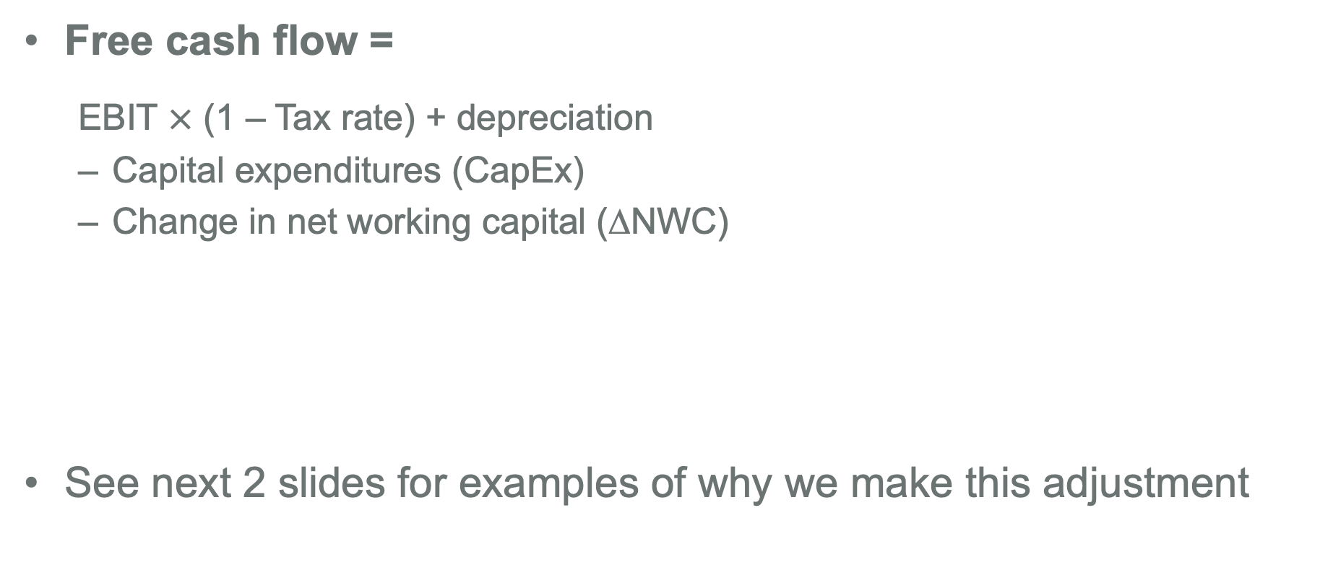
Last step, subtract ∆NWC
Free cash flow =
EBIT $×$ (1 – Tax rate) + depreciation
Capital expenditures (CapEx)
Change in net working capital (∆NWC)
See next 2 slides for examples of why we make this adjustment

Slide 24
Example #1 – Accounts receivable
Why is subtracting changes in accounts receivable needed…
When there is an increase in accounts receivable?
When there is a decrease in accounts receivable?

Slide 25
Example #2 – Inventory adjustment
Why is subtracting changes in inventories needed…
When there is an increase in inventory?
When there is a decrease in inventory?

Slide 26
To find ∆NWC, you first need to estimate NWC
Do this by estimating the amount of each current asset & liability the investment will entail in future years; e.g.,
What is predicted account receivables in each year of investment?
What is predicted amount of inventory needed each year?
And in last year of investment, you set NWC to zero [Why?]
This last step is often referred to as “recapturing” or “recovering” working capital

Slide 27
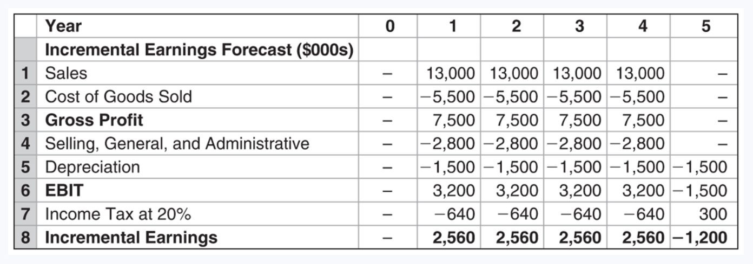
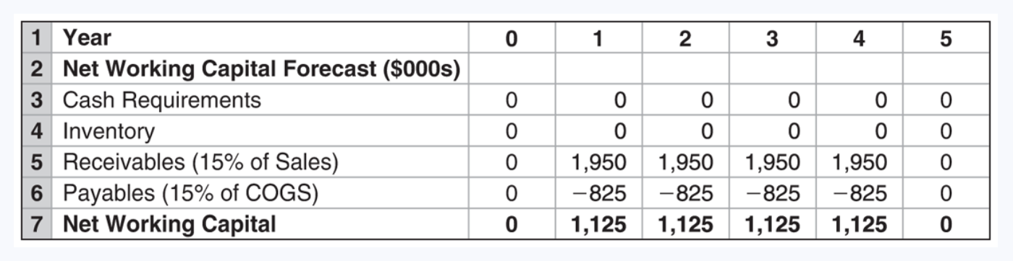
Practice question [Examples 9.4-9.5 of textbook]
Please take 10 minutes to answer the below questions.
Cisco is thinking about developing a new networking device and has created these cash flow estimates. If the investment will cost $7.5 million (and has no salvage value), what is the incremental FCF each year? And if the appropriate cost of capital is 12%, what is the NPV?

Slide 28
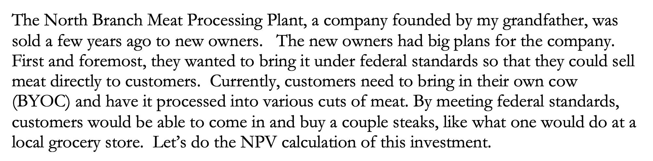
Practice question [available on Canvas]
Let’s now work together to build our own pro forma estimates
Setup is as follows & detailed projections are on next slide

Slide 29
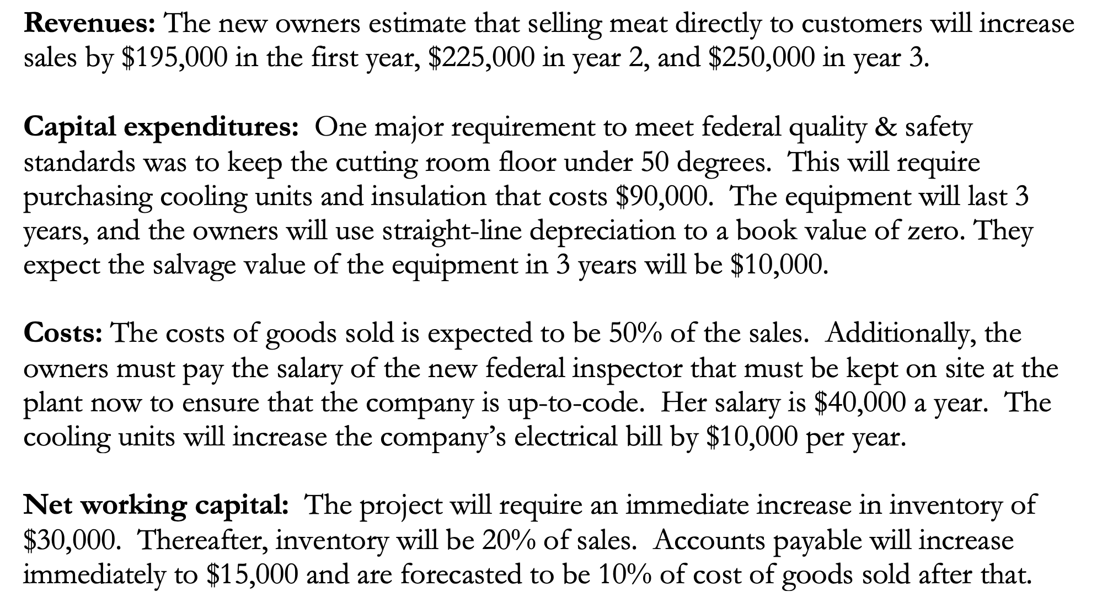
Practice question [see handout]

Slide 30
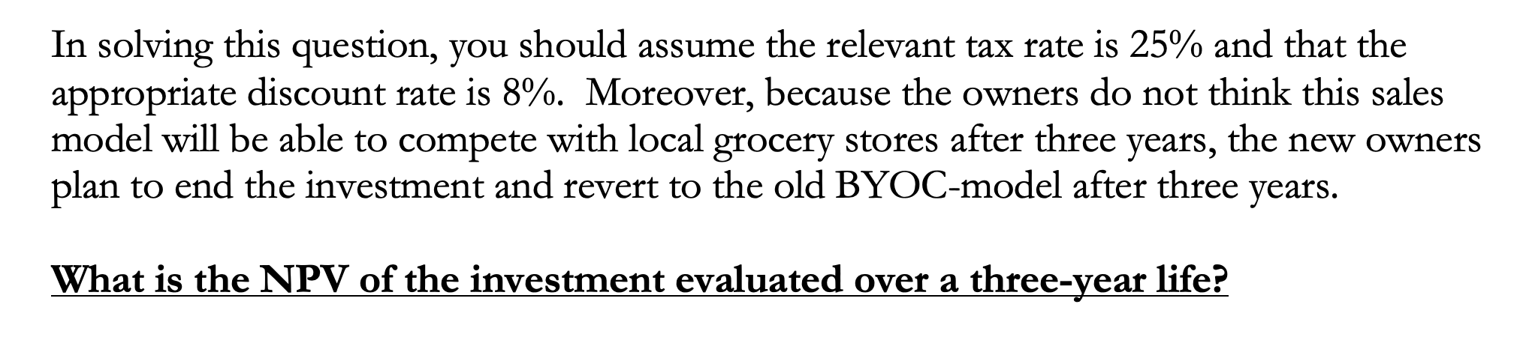
Practice question [continued]
Let’s now build out the necessary MS Excel file and work through the solution one piece at a time…

Slide 31
Practice solution [available on Canvas]
If the solution we just worked through in class together went too quickly for you, please see the completed solution on Canvas
See MS Excel file “FCF and NPV Practice Solution” under handouts
You can see solution formulas used by clicking on each cell

Slide 32
Outline for this topic
Continue “capital budgeting” decision by discussing how to calculate cash flows for project valuation
Discuss “free cash flows” (FCFs)
Define and explain FCFs
Steps to finding a project’s FCFs
Miscellaneous issues with FCFs
Apply tools using “Worldwide Paper” case

Slide 33
Before doing FCF case… a few more things
Calculating depreciation
Negative tax expenses
Analyzing the NPV estimation

Slide 34
Calculating depreciation
Firms always depreciate assets to a book value of zero [Why?]
Firms always want to depreciate as quickly as possible [Why?]
So, government sets rules on how quickly assets can be depreciated; Modified Accelerated Cost Recovery System
Specifies # of years each type of asset is depreciated over
And specifies fraction of purchase price firm can depreciate each year
Will be better than “straight-line” approach shown earlier

Slide 35
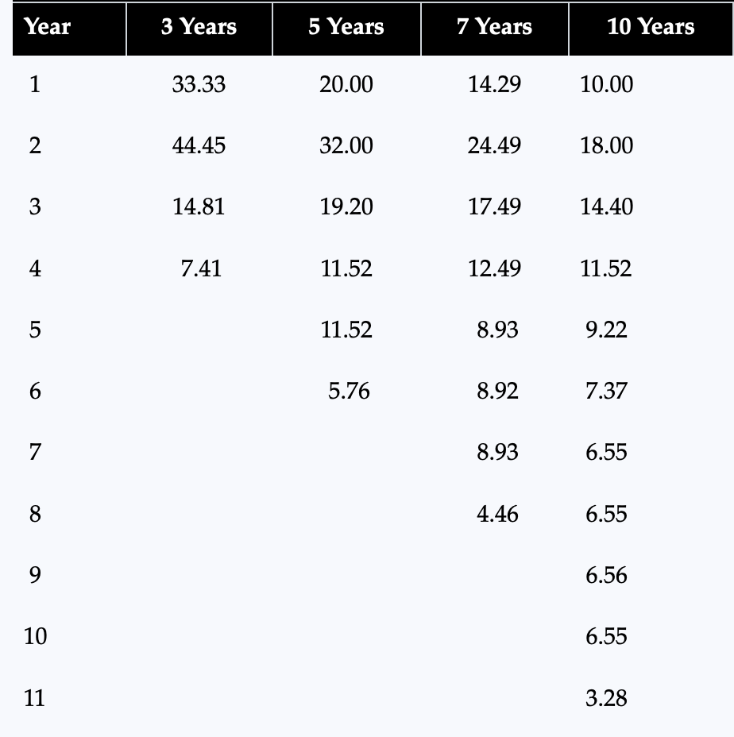
MACRS depreciation table
Table shows percentage of asset’s cost that may be depreciated each year based on allowed recovery period
See Chapter 9 appendix if you are interested in more details
Columns always sum to 100%
Table 9.4: Berk, Demarzo, and Harford, Fundamentals of Corporate Finance, 5th Edition

Slide 36

Negative taxes
Sometimes, estimated EBIT of project is negative
In that case, your projected free cash flow will include a negative tax expense, EBIT $×$ Tax rate… Why do we include that?

Slide 37
Analyzing the NPV estimation
Estimate of cash flows for NPV requires lots of assumptions!
Given that, it is always important to determine what assumptions are most important in yielding a positive NPV
Intuitively, what are some ways you think you could do that?

Slide 38
Types of NPV analysis
Sensitivity analysis
Changing only one parameter at a time, calculate the NPV under the best- and worst-case assumption for each parameter… Parameters causing big NPV swings require more attention!
Break-even analysis
For each parameter, find the level at which NPV is zero (holding all other assumptions constant)... Are you confident you can hit that level?
Scenario analysis
What does NPV look like if multiple parameters change at once… E.g., what if economy doesn’t bounce back after Covid?

Slide 39
Tips on doing these types of project analysis
Build estimates in MS Excel in the following way:
1st tab includes & organizes all assumptions being made
2nd tab includes incremental cash flow estimates (by year) that are constructed by referencing values on the 1st tab
Never type a value directly in this 2nd tab
Every cell on this 2nd tab, including NPV calculation, should be a formula
If done correctly, can then easily change assumptions on 1st tab to see how cash flows & NPV on 2nd tab change

Slide 40
Additional MS Excel tips…
Do one column (i.e., year) first, then copy & paste those formulas to other columns (i.e., later years)
Avoids redoing formulas again
To copy & paste, just highlight column cells & drag from bottom right box
Use “Command” + “T” to fix cell reference in formula
This will add $ signs into selected cell reference that tells MS Excel to not change that cell when you later do the copy & paste for other columns

Slide 41
Group assignment – Worldwide Paper Company
Take 75 minutes as group to answer questions on group case handout #3 about the “Worldwide Paper Company” (WPC)
I would recommend starting with “Template” tab in the “FCF and NPV Practice Solution” MS Excel file, and making modifications to it as needed to account for assumptions in the WPC
Upload answers as MS Excel, MS Word, or MS PowerPoint file to Canvas

Slide 42
Wrapping up FCF discussion
Before we wrap-up the FCF discussion, I want to show you one other powerful use of FCFs commonly done in finance…

Slide 43
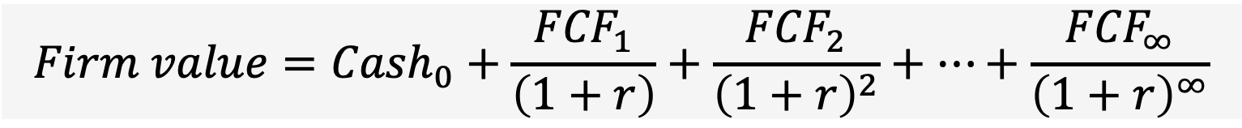
Valuing an entire company [not just a project]
We can also use DCF to value an entire firm! [I.e., the value of all the firm’s assets & projects]
Now, use FCFs of entire firm
$$Firm value={Cash}_{0}+\frac{{FCF}_{1}}{\left(1+r\right)}+\frac{{FCF}_{2}}{{\left(1+r\right)}^{2}}+…+\frac{{FCF}_{∞}}{{\left(1+r\right)}^{∞}}$$
And, add in current cash holdings of firm
When might knowing this value be useful in practice?

Slide 44
Can use firm value to get stock price…
If prior formula equals asset value, how do we find equity value?
And once we have total equity value, how to find stock price?

Slide 45
Finding equity value & stock price using DCF
Firm value obtained by DCF tells us value of firm to all investors–both equity holders and debt holders; so,
Equity value = Firm value – Debt
Stock price = Equity value / Shares outstanding

Slide 46
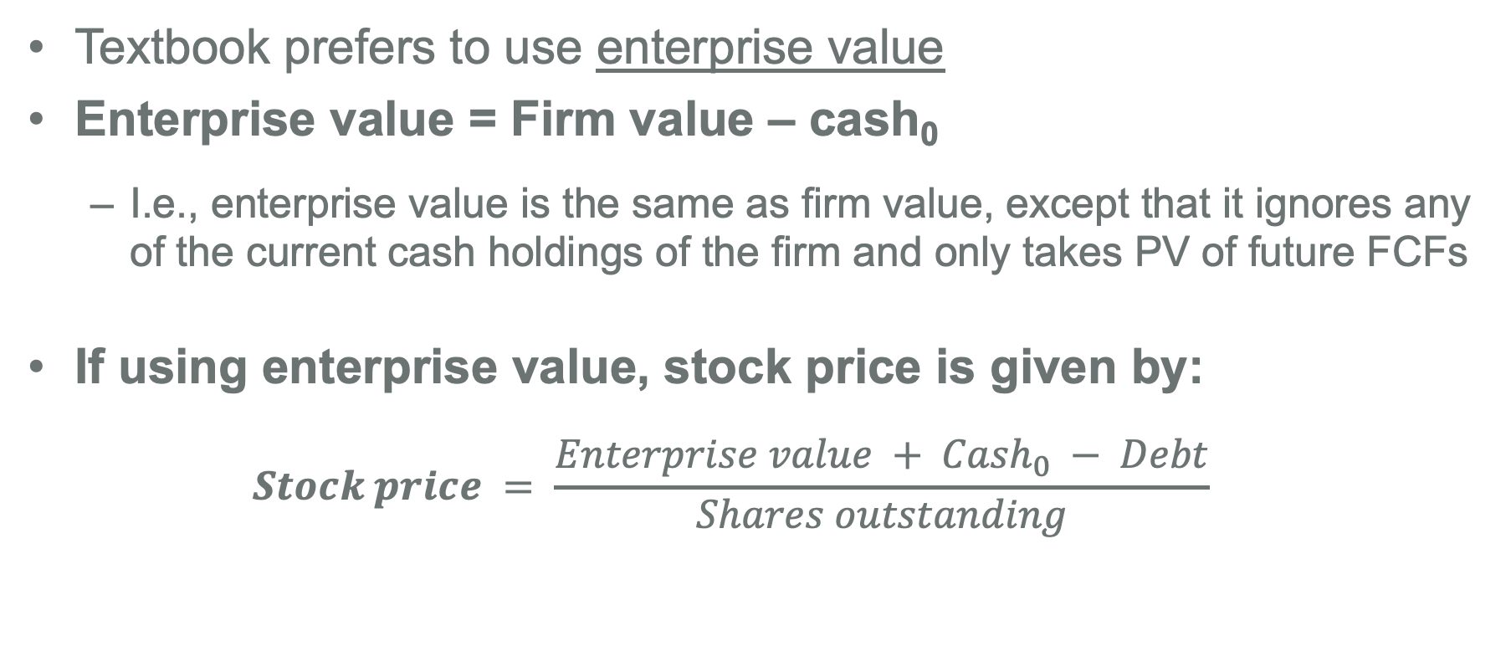
“Firm value” versus “Enterprise value”
Textbook prefers to use enterprise value
Enterprise value = Firm value – cash₀
I.e., enterprise value is the same as firm value, except that it ignores any of the current cash holdings of the firm and only takes PV of future FCFs
If using enterprise value, stock price is given by:
$$Stock price = \frac{Enterprise value + {Cash}_{0} − Debt}{Shares outstanding}$$

Slide 47
Key points to remember
NPV is the present value of a project’s incremental FCFs
To find these FCFs:
Create pro forma income statement and estimates of CapEx and NWC
Use these projected estimates to find FCF;
Free cash flow =
EBIT × (1 – Tax rate) + depreciation
– Capital expenditures (CapEx)
– Change in net working capital (∆NWC)
Don’t forget about recovery of NWC and assets’ salvage value!
See MyLab Finance homework for yet even more opportunities to practice these concepts & calculations

Slide 48
Where we are going…
What I haven’t told you yet, is how we find the appropriate discount rate, r, to use for our DCF valuations
The discount rate will capture riskiness of cash flows
And when valuing company, it equals what we call the weighted average cost of capital (WACC)
But first, any questions before we move on?

